Slide 1
Lane Medical Library: Screencasting Proposal
(focusing on access, services, and dissemination of information for users)
By Shannon Meaney

Slide 2
Project Description
Lane Liaisons will create, develop and implement screencasts tailored to their specific specialties and user groups
Screencasts will be available 24/7 and users will be able to access them whenever they need assistance.
Users will be more comfortable and confident in their ability to find their resources and take advantage of what Lane has to offer
they will elevate overwhelmed librarians from answering redundant questions and leave them with more time for answering more complex questions

Slide 3
Project Description (Cont.)
Screencasting:
easy for users to understand
easy for staff to create
will enhance online learning
they will be able to access online tutorials that instruct them step by step on how to use the resource or service that users need
they can be created on the fly or for formal online tutorials

Slide 4
Software
Jing (free software)
Camtasia (Lane already has a subscription)

Slide 5
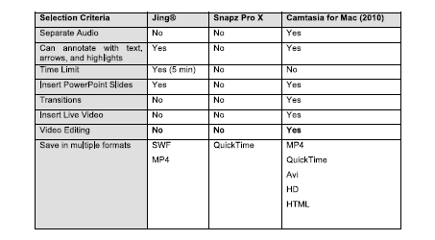
Software

Slide 6
Target Needs and Assessment
In late 2009 Lane conducted a comprehensive survey, asking users about Lane’s website, resources and space.
Users answered questions online and/or in paper form

Slide 7
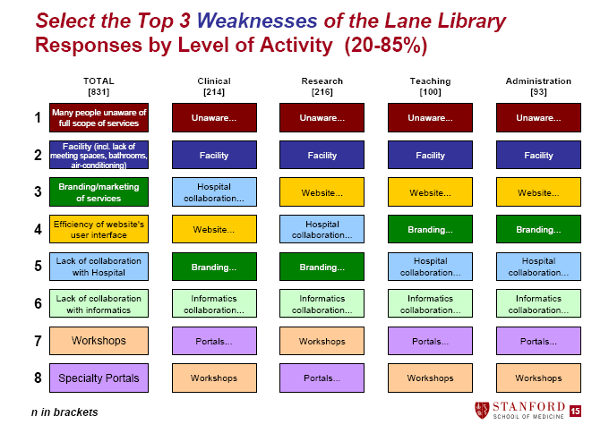
Target Needs and Assessment (cont.)
Survey Results: 2009
Lane Medical Library. (2010)

Slide 8
Survey Results
The survey showed that an overwhelming 90% of users had little or no knowledge on what database, journals and books that Lane subscribes to
Identified user’s unawareness of services as the number one weakness of the Lane Library

Slide 9
Outcome of Survey
Lane’s objective is to increase the effective use of library services by creating and implementing new outreach and access strategies that are user friendly, have low budget impact, and use existing free technology

Slide 10
Screencasting
Create, develop and implement screencasts for Lane users
Publish screencasts and publish/link guides on lane.stanford.edu. and portals
Create a marketing buzz by advertising on lane.stanford.edu, Facebook, Lane RSS feeds and the Lane newsletter
Create manuals and teach courses and workshops on how use create screencasts with tips and tricks

Slide 11
Timeline
Projects | Description | Cost | Owner | Completion Date | Measurement | Progress
Create and implement Screencasts | Screencasts will be created and implemented/published on Lane LibGuides and Website for many of Lane’s User Groups | Jing is free /Stanford already has subscription to Camtasia software:Staff time | SM/TC | Fall 2011 and ongoing | Committee to monitor hits and questions | Evaluate in 6 months after publication
Create a marketing plan for Screencasts | Facebook, RSS Feeds, e-mail,newsletter, website,outreach events, workshops | Online software For charge cards: Staff time | SB/SM | Spring 2012 | Amount of usage | Evaluate 3 months after installation

Slide 12
Personnel
Liaison Training: The Director of Access Services, Sandra Brekke and Liaison Marilyn Tinsley, will conduct a 2 hour training for all Lane Librarians
Staff Training: The head of Circulation, Shannon Meaney, will provide one hour training on how to screencast. The training will include an introduction on how to find and use the screencast tutorials when answering reference questions. Staff will be instructed on how to teach users to navigate through the screencasts on the phone, meebo chat, and at the desk.

Slide 13
Project Promotion
Lane’s Website will house all of Lane’s screencasts
lane.stanford.edu
Screencasts will be promoted:
website -RSS Feeds
Outreach Events -e-mails
Instruction/Workshops -Newsletter
Facebook

Slide 14
Project Sustainability
Sustainability and maintenance will be an important aspect of keeping the screencasts current and useful to Lane’s users.
Maintain an inventory of guides. All maintenance will be done by the library liaisons/subject specialists
Identify long-term editors who will oversee the entire collection of screencasts

Slide 15
Project Budget
The library’s budget for new programs and services is minimal. Library administration allotted $2000 for new programs and services for 2011-2012. The proposed budget for these new services are justified because the expenditures clearly focus on end user needs and will result in more effective and efficient use of the existing and previous investments in the Library

Slide 16
Project Budget (Cont.)
Proposal Expense | Amount
Jing Screencast Software License | Free Subscription
Camtasia Screencasts Software License | $199 per year with 89 upgrade
Training | Screencast Training: $0: Staff Time: 2 Hour Training. Once implemented redirection of staff time, additional duty.
Headsets | 3 headsets Logitech ClearChat™ PC Wireless $99 each

Slide 17
Questions?

